Slide 1
MTE Heat Treatment Ltd Our strength is your performance
Subcontract services Specializing in Gear heat treatment with complimentary machining processes

Slide 2
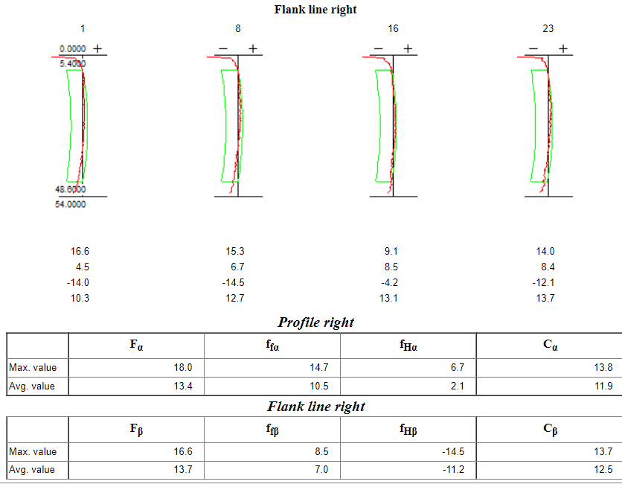
MTE – Dedicated Gear Heat treatment specialist
Industry proven gear processing with over 50 years experience
Committed to process development
Tailored process leading to minimal in process movement
Capability to measure and adapt processes
Customer focused to define best process flow
Dedicated to continuous improvement
Implementation of IATF 16949

Slide 3
Market Challenges
Capacity constraints within the general heat treatment market.
Processing costs – resources/consumables, utilities, labour and transport
Drive to net zero – use of natural gas key within the process

Slide 4
Cramlington - MTE
Project CAM announced OCT 2021 – phase out of product beginning July 2022
Volume reduction – related to 1 full furnace capacity reduction, overall, with CPFL
Production volumes increased from August 2022
Oct 2022 volume requirement running at 14000 pieces per week
Jan – Mar 2022 – MTE met with current and past customers.
July 2022 – Notified of main competitor closure – number of enquiries received
Sept 2022 – Visits and audits with potential new customers
Validation of new business

Slide 5
Sealed Quench Heat Treatment
Three sealed quench furnaces
Each with 1000Kgs load capacity
Semi Automatic operation
Latest technology for controls, monitoring and safety
Part specific tooling available
Integrated wash and temper
Carburizing, direct quench, harden and temper, selective carburizing
Gas analysis control

Slide 6
Pit Furnace Heat Treatment
Four pit furnaces
Controlled and air blast cooling
Carburizing, Normalizing, Annealing, selective carburizing.
Latest controls and monitoring including gas analysis

Slide 7
Gleason Quenching
Precision quenching to meet finished dimensional tolerances
Unique tooling for each component.
Variable quench rates to suit component geometry
Ergonomic process flow

Slide 8
Induction Hardening
Single shot and scanning capabilities
Low, medium and high frequency machines
Quality control of machine parameters giving instance component approval
Locally sourced tooling

Slide 9
Shot Peening/Shot Blasting
Air blast peening
Two and three axis movement – with computer positioning control
Interchangeable shot facility
Two hanger blast machine
Single table blast machines
Component specific tooling available

Slide 10
Gear Cutting
5 hobbing machines capable of up to 400mm (15.5”)
3 shaping machine with both internal and external capability
5 shaving machines capable of up to 405mm (16”)

Slide 11
Machining
4 axis CNC machining center
Broaching – Horizontal processing
Grinding – Internal, External and Spline
Gear grinding currently being comissioned
Hydraulic shaft straightening

Slide 12
Laboratory
Microstructural examination
Spectrographic analysis
Magnetic Particle Inspection
Eddy Current inspection
CMM dimensional measurement, with Gearpak technology
Hardness testing in accordance with ASTM standards – including macro and micro-Vickers, Rockwell and Brinell
Failure analysis capability
Distortion monitoring and control through sealed quench process

Slide 13
Certifications / Contacts
Certified to ISO 9001:2015
FS555942
Certified to ISO 14001:2015
EMS586304
Working towards IATF 16949:2016
Technical
jasonbeaumont@mteltd.co.uk
Sales
sales@mteltd.co.uk
Accounts
accounts@mteltd.co.uk

